Slide 1

AI Journey – Small To Big Steps
gwest@redhat.com
April 8, 2025

Slide 2
AI Learning for April 2025
First AI Productively – RDS and Openshift deployment changes
Second AI Productivity – Using full AI Generation for IOT Devices

Slide 3
Simple Deployment Script AI Generation
Original rds deployments were done with via “POD” definitions
Wanted to move to Openshift Deployments
Conceived from “Medium” Article
https://medium.com/@whaleberry/convert-pod-to-deployment-in-kubernetes-b0f2fc362b21

Slide 4
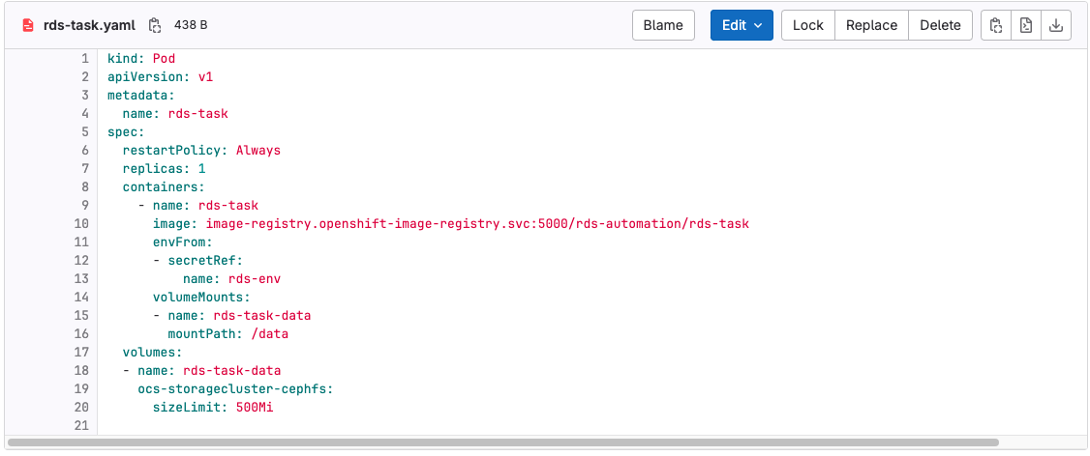
Original Pod Description

Slide 5
Deployment
1. Install Amazon Q Developer plugin to Visual Studio
2. Opened rds-task-deploy.yaml” in visual studio
3. Open Amazon Q Developer Chat window:
”Change Pod to deployment”

Slide 6
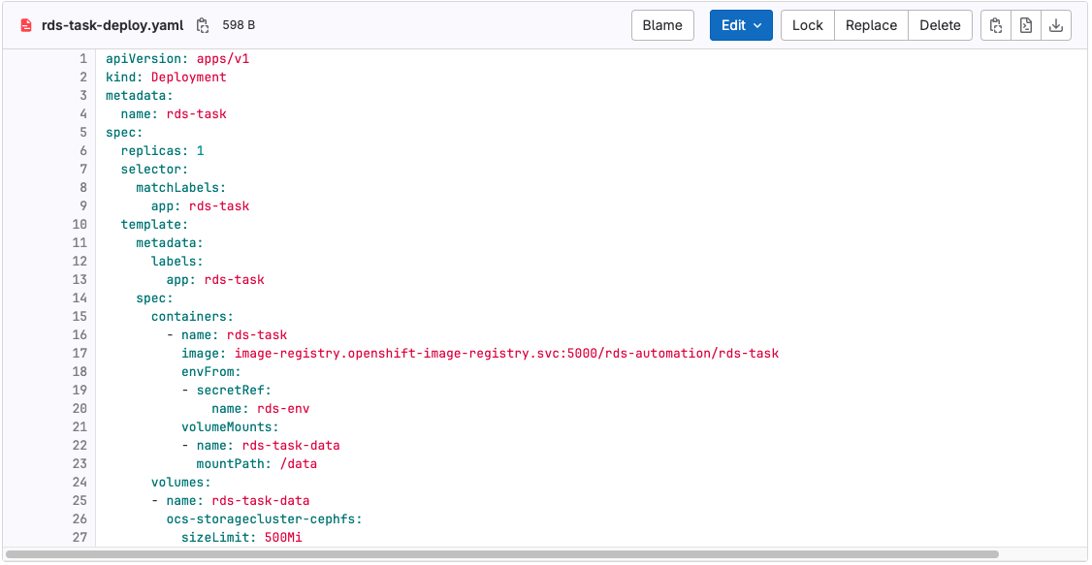
Result

Slide 7
Steps
The result came as a block in “chat”
Verified that the config was ok
Copy pasted it into the deployment yaml, used it to create the pod.
Worked first time
As yaml are tab/white space, and editing usually means a few tries to get spacing just right, this did it in a moment.

Slide 8
Further Tests
Converted worker, rabbitmq and redis into deployments.
All were one and done
Opened all deployments, and ask “Q Developer” to combine all the deployments
It then showed the complete deployment
Tested rds-deploy-all.yaml
Worked first time
Cleaned up repo, removed 10 files/deleted 279 lines

Slide 9
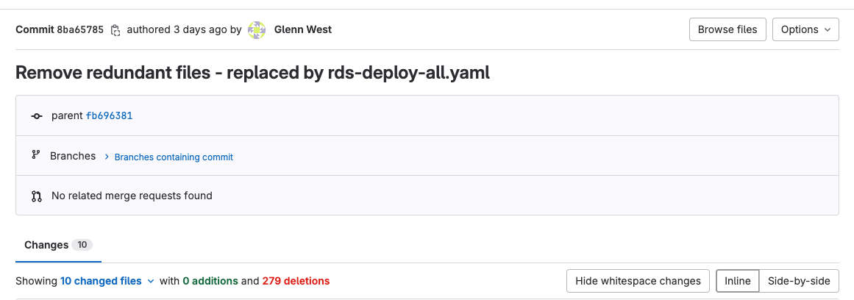
Result

Slide 10
Thoughts
At this time, do not “trust” AI to write code, but good for config/yaml fixups.
For config/yaml, I did try some other changes, but it seemed to have “version” issues as things have changed over time. As this was secondary, did not followup

Slide 11

Using AI for IOT Design
IOT Design consists of hardware and software
Personal Goal for design a IOT Device for “Blinds” control

Slide 12
What is blindscontroller “hardware”
USB-C Power input from power bank
Must be 12Volt for torque
USB-PD Controller to tell power bank, ”Please give me 12V”
A dc-to-dc stepdown converter for 3.2 Volts
ESP32-C6 – Microcontroller
ULN2003 Motor Controller
Hardware design Steps
Schematic Capture
Component Selection/Costing/Models
PCB Layout
PCB Routing
PCB Cleanup
BOM Creation

Slide 13
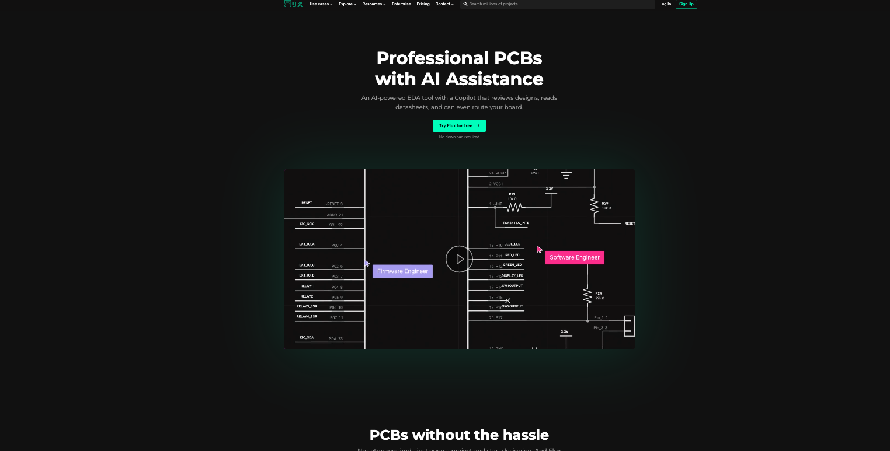
FluxAI
Based on some search on iot/board design discovered fluxai
Demo’s looked neat
Edorsements looked cool
Marketing was great

Slide 14
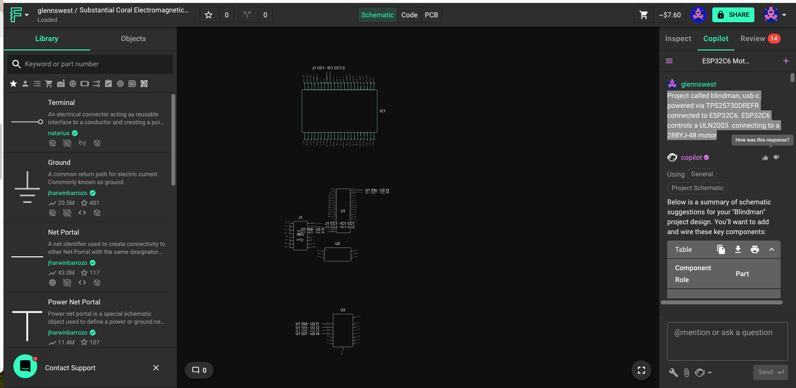
How does it work:
You “chat” to the ai, requesting what you want:
“Project called blindman, usb-c powered via TPS25730DREFR connected to ESP32C6. ESP32C6 controls a ULN2003. connecting to a 28BYJ-48 motor”

Slide 15
RESULT

Slide 16
Thoughts
They work to hard on “marketing”, on making it cute:
They named my project ”Substation Core Electromagnet…..”
When there getting ready to do something they add nonsense messages “Charging Flux Capacitor”
Interactions:
Slow, and bad chat interface, multiple confirms, long delay between
Horrible quality
Tried for 2 hours

Slide 17
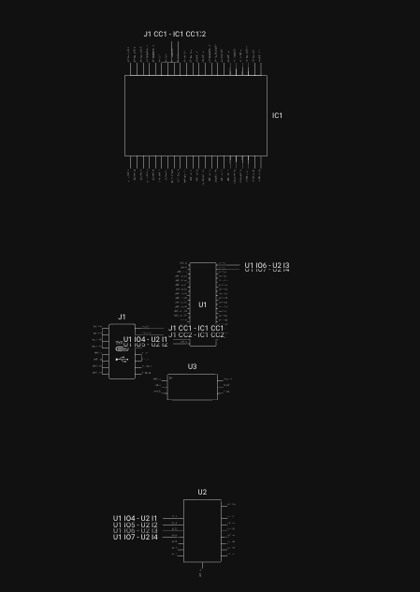
Unusable
Just randomly placed bits
Hardware design its important
Be neat
Every choice affects outcome/price/performance
Takes to long

Slide 18
Alternative
Installed kicad
Used “ultralibrarian” for known good schematic/pcb symbols
Proceeded to learn kicad, and design first stage
Previously have used “Altium”
Never used kicad before

Slide 19
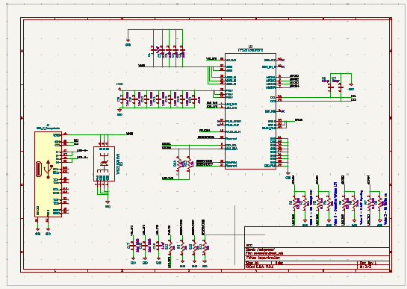
Result

Slide 20
Final Thoughts
AI is very good at some repeatable tasks
Version control can be a problem – Which version of openshift was the model trained on
More detailed tasks, trust is really a issue: In IOT/PCB design, things like “use 10uf capacitors/multiples could save you several dollars” does not seem to be in current AI
While my “kicad” first page took me 4-5 hours the quality was 100%, I spent about 2 hours trying Flux-AI and got nothing. Im sure that at some point, AI can design simple boards, but experience still is king.
May be better for auto-routing/design checks etc.

